Slide 1
Downcasting with java instanceof operator

Slide 2
When Subclass type refers to the object of Parent class, it is known as downcasting. If we perform it directly, compiler gives Compilation error. If you perform it by typecasting, ClassCastException is thrown at runtime. But if we use instanceof operator, downcasting is possible.
Dog d=new Animal();//Compilation error
If we perform downcasting by typecasting, ClassCastException is thrown at runtime.
Dog d=(Dog)new Animal();
//Compiles successfully but ClassCastException is thrown at runtime

Slide 3
downcasting with instanceof
class Animal { }
class Dog3 extends Animal {
static void method(Animal a) {
if(a instanceof Dog3){
Dog3 d=(Dog3)a;//downcasting
System.out.println("ok downcasting performed");
}
}
public static void main (String [] args) {
Animal a=new Dog3();
Dog3.method(a);
}
}

Slide 4

Static Binding and Dynamic Binding
Connecting a method call to the method body is known as binding.
There are two types of binding
static binding (also known as early binding).
dynamic binding (also known as late binding).

Slide 5
Understanding Type
Let's understand the type of instance.
1) variables have a type
Each variable has a type, it may be primitive and non-primitive.
int data=30;
Here data variable is a type of int.
2) References have a type
class Dog{
public static void main(String args[]){
Dog d1;//Here d1 is a type of Dog
}
}

Slide 6
An object is an instance of particular java class,but it is also an instance of its superclass.
3) Objects have a type
class Animal{}
class Dog extends Animal{
public static void main(String args[]){
Dog d1=new Dog();
}
}
Here d1 is an instance of Dog class, but it is also an instance of Animal.

Slide 7
static binding
When type of the object is determined at compiled time(by the compiler), it is known as static binding.
If there is any private, final or static method in a class, there is static binding.
Example of static binding
class Dog{
private void eat(){System.out.println("dog is eating...");}
public static void main(String args[]){
Dog d1=new Dog();
d1.eat();
}
}

Slide 8
Dynamic binding
When type of the object is determined at run-time, it is known as dynamic binding.
Example of dynamic binding
class Animal{
void eat(){System.out.println("animal is eating...");}
}
class Dog extends Animal{
void eat(){System.out.println("dog is eating...");}
public static void main(String args[]){
Animal a=new Dog();
a.eat();
}
} Output:dog is eating...

Slide 9
Virtual method invocation
We already have discussed method overriding, where a child class can override a method in its parent. An overridden method is essentially hidden in the parent class, and is not invoked unless the child class uses the super keyword within the overriding method.

Slide 10
example
public class Employee { private String name;
private String address;
private int number;
public Employee(String name, String address, int number) {
System.out.println("Constructing an Employee");
this.name = name;
this.address = address;
this.number = number; }
public void mailCheck() {
System.out.println("Mailing a check to " + this.name + " " + this.address); }
}
public class Salary extends Employee {
private double salary; // Annual salary
public Salary(String name, String address, int number, double salary)
{ super(name, address, number);
setSalary(salary); }
public void mailCheck()
{ System.out.println("Within mailCheck of Salary class ");
System.out.println("Mailing check to " + getName() + " with salary " + salary); }}

Slide 11
public class VirtualDemo
{
public static void main(String [] args)
{
Salary s = new Salary("Mohd Mohtashim", "Ambehta, UP", 3, 3600.00);
Employee e = new Salary("John Adams", "Boston, MA", 2, 2400.00);
System.out.println("Call mailCheck using Salary reference --");
s.mailCheck();
System.out.println("\n Call mailCheck using Employee reference--");
e.mailCheck(); } }

Slide 12
Output
Constructing an Employee
Constructing an Employee
Call mailCheck using Salary reference –
Within mailCheck of Salary class
Mailing check to Mohd Mohtashim with salary 3600.0
Call mailCheck using Employee reference—
Within mailCheck of Salary class
Mailing check to John Adams with salary 2400.0
Here, we instantiate two Salary objects. One using a Salary reference s,
and the other using an Employee reference e.

Slide 13
Here, at compile time, the compiler used mailCheck() in Employee to validate this statement. At run time, however, the JVM invokes mailCheck() in the Salary class.
This behavior is referred to as virtual method invocation, and these methods are referred to as virtual methods
An overridden method is invoked at run time, no matter what data type the reference is that was used in the source code at compile time.

Slide 14
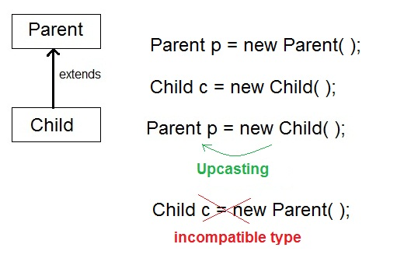
Dynamic method dispatch
Runtime Polymorphism or Dynamic method dispatch
Dynamic method dispatch is a mechanism by which a call to an overridden method is resolved
at runtime. This is how java implements runtime polymorphism. When an overridden method is
called by a reference, java determines which version of that method to execute based on the type
of object it refer to. In simple words the type of object which it referred determines which version
of overridden method will be called.
Upcasting
When Parent class reference variable refers to Child class object, it is known as Upcasting

